Slide 1
What Do These Pieces of Art have in common?

Slide 2
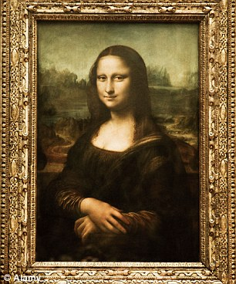
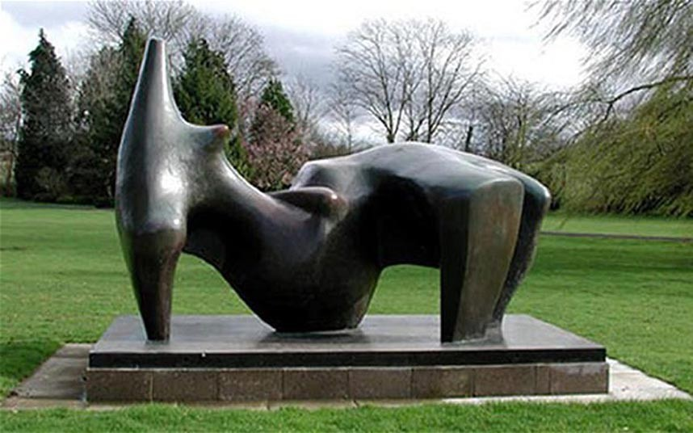
In pairs, take a look at these paintings.
With you partner, make a quick list on lined paper of 4 things you think they might have in common.
You have 4 minutes.

Slide 3
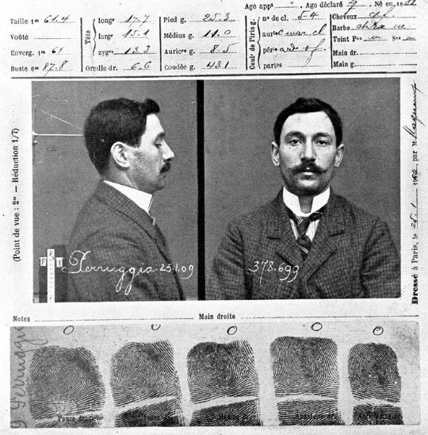
Mona Lisa by Leonardo Da Vinci
The Mona Lisa is a half-length portrait of a woman by the Italian artist Leonardo da Vinci, which has been acclaimed as "the best known, the most visited, the most written about, the most sung about, work of art in the world". It is believed to have been painted between 1503 and 1506 – over 500 years ago.
In 1911, Vincenzo Perugia, an Italian immigrant and Louvre employee walked into the museum, placed the Mona Lisa under his coat and simply walked out, in an attempt to reclaim the famous Leonardo Da Vinci work for his homeland. He was caught two years later trying to sell the piece to an Italian museum in Perugia, and got off with a one-year sentence. Security at the Louvre has since improved.

Slide 4
Sunflowers By Vincent Van Gogh
'Sunflowers' by Vincent van Gogh
In 1991, two thieves broke into the Van Gogh Museum in Amsterdam and stole 20 paintings, including the globally-known Sunflowers. Luckily, the art world breathed a sigh of relief when all of the paintings were found intact in the getaway car hours later...

Slide 5
Reclining Figure by Henry Moore
The bronze sculpture “Reclining Figure”, worth $6 million, was stolen from a 72-acre estate of the Henry Moore Foundation in the UK, in December 2005. It took thieves 10 minutes using a stolen crane-equipped flatbed Mercedes truck to carry it away. A global alert was issued but, apart from a sighting by another motorist at a road junction nearby the same evening, it was never seen again. Police said inquiries revealed the artwork was moved through 2 scrap metal dealers in England. It was then shipped abroad, possibly to Holland, and then further east.
He said estimates suggested the sculpture, three metres long and two metres high, may have made just £1,500 as scrap metal if it was melted down. Only 5-8% of all stolen art is recovered.

Slide 6
Edvard Munch’s "The Scream"
In 1994, the same day as the opening of the 1994 Winter Olympics in Norway, two men broke into the National Gallery, Oslo, and stole The Scream, leaving a note reading "Thanks for the poor security". After the gallery refused to pay a ransom demand of US$1 million, Norwegian police set up a sting operation with the British police and the painting was recovered on the 7th May, 1994. In 1996, 4 men were convicted in connection with the theft, but they were released on appeal on legal grounds: the British agents involved in the sting operation had entered Norway under false identities.
The Scream was stolen again on 22 August, 2004, by 4 masked gunmen. A bystander photographed the robbers as they escaped. In 2005, Norwegian police arrested a suspect, but the paintings remained missing. It was rumored that they had been burned by the thieves to destroy evidence. In June, 2005, with four suspects already in custody, the city of Oslo offered a reward of US$313,500 for information that could help locate the paintings. Although the paintings remained missing, six men went on trial in early 2006. Three of the men were convicted and sentenced to between 4 & 8 years in prison in 2006. Later, Norwegian police announced they had recovered The Scream, but did not reveal how.
Edvard Munch, the Norwegian expressionist painted The Scream between 1893 and 1910.

Slide 7
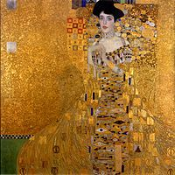
Art that has been Stolen
Click the picture…for art that has been stolen

Slide 8
What might We wonder About Stolen Art?
With your pair partner what are things that you might wonder about stolen art?
In pairs, make a list of at least 4 questions.
You have 3 minutes.
The modern museum robbery can be quite organized and spectacular, like the Museum of Fine Arts heist in Montreal in 1972, in which 18 paintings and 37 other pieces were removed by thieves in 30 minutes; or the burglary of the National Gallery in Stockholm in 2000, where thieves used diversionary explosions, tire-puncture devices and a getaway boat. Hollywood portrayals of art theft perpetuate the idea that it’s a non-violent, victimless crime, commissioned by big art collectors…So who really steals the stuff, and why?

Slide 9
Possible Questions..
Who steals art? Are they stealing for themselves?
Why do people steal art? (Money? Collections? Commissioned by someone?)
How do you sell the art that has been stolen?
How often is the art recovered?
How is art recovered?
Is it mostly one painting or big thefts?
What sort of security is there around art. Do you get searched on the way into museums?
Is there a typical pattern for theft?

